Slide 1
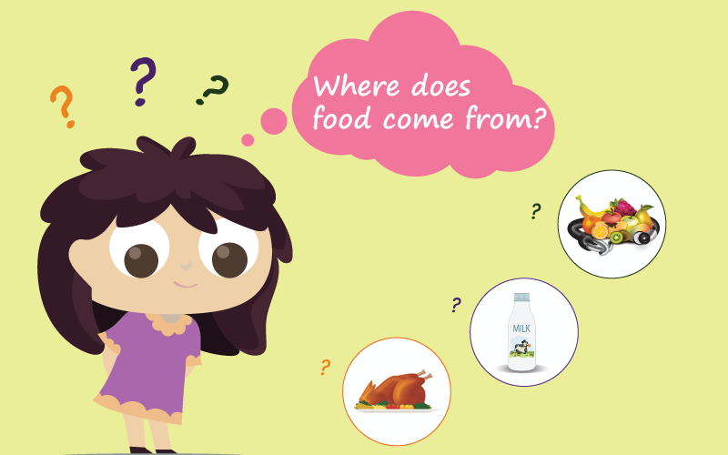
Food: Where does it come from?

Slide 3
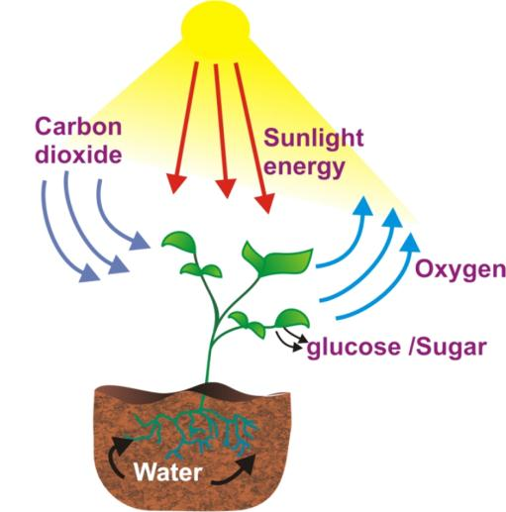
Sunlight as a source of energy(food)

Slide 4
FOOD FROM PLANTS
Green plants are known as producers because they prepare their own food . They use light, air (carbon dioxide) water and chlorophyll (the green pigment in their leaves) to prepare the food by the process of photosynthesis.

Slide 5
Activity 1
Ask your friends in the school about the items they would be eating during a day,
from friends staying in different states .
Name of the student/friend | student/friend Food items eaten in a day
Rashmi | Dhokla’roti and sabzi.
Roshni | Makki roti,with sason saag
Harish | Biryani.

Slide 6
Activity 2
Choose some of the items you listed in Table 1.1 and try to find out what ingredients are used to prepare these
Table 1.2 Food items and their ingredients
Ingredient: Any of the foods or substances that are combined to make a particular dish
Food Item | Ingredients
Roti /chapati | Atta , water
Dal | Pulses, water, salt, oil, ghee , spices

Slide 7
Activity 3
Table 1.3 Ingredients used to prepare food items and their sources
Idli
Rice Plant Urad dal Salt Water
Chicken Spice Spices
Oil/ ghee
Chicken curry
Animals
Plants/
Animals
water
Milk Animal Rice Plant Sugar
Kheer

Slide 8
Think of more examples where two or more parts of a single
plant are used as food.
Table 1.4 Plant parts as food
Food item with plant as the major sourc | Ingredients/source | Plant part which gives us the ingredient
1. Brinjal curry | Brinjal curry Chilli as spice (any other) Oil from groundnut, mustard, soybean, any other plant | 1.Fruit Fruit seed
2.
3.

Slide 9
Activity 4
Choose those items whose ingredients are obtained from plants. Which part of a plant? Identify these and list the food items and plant parts as shown in Table 1.4.

Slide 10
Activity 5
Do you know where honey comes from, or how it is produced? Have you seen a beehive where so many bees keep buzzing about? Bees collect nectar (sweet juices) from flowers, convert it, into honey and store it in their hive (Fig. 1.7). Flowers and their nectar may be available only for a part of the year. So, bees store this nectar for their use all through the year. When we find such a beehive, we collect the food stored by the bees as honey.

Slide 13
Different parts of plants as a source of food

Slide 14
Fruits

Slide 15
Seeds

Slide 16
Types of vegetables

Slide 18
FOOD

Slide 20
Main sources of food

Slide 21
On the basis of food habits

Slide 22
Different animals have different feeding habits. These animals are grouped into three types: herbivores, carnivores and omnivores .
Herbivores-herbivores animals are those that eat plant and plant products
Carnivores- carnivores are the animals that eat flesh of other animals.
Omnivores-omnivores are the animals that eat both plants and the flesh of other animals.
Eg. Bear, crow and human being ,

Slide 23
Carnivores
Herbivores
Omnivore

Slide 24
Source ;- www.bing.com

Slide 25
Activity 6
Table 1.5 Animals and their Food.
Name of the animal | animal Food the animal eats
Buffalo | Grass, oilcake, hay, grains
Cat | Small animals, birds ,milk
Rat | Cherries. Chicken
Lion | buffaloes, goats, nilgai
Tiger | moose, deer species, pigs, cows, horses, buffalos and goats
Spider | insects
House lizard | insects
Cow | Grass,straw
Human beings | Fruits, roti, rice etc
Butterfly | tree sap, dung, pollen, or rotting fruits.
Crow | Grass, straw
Other

Slide 26
Table 1.6
Herbivores | Carnivores | Omnivore
Cow | Lion | Dog
goat | fox | cat
buffalo | wolf | bear
horse | shark | pig
Paheli wants to know where you would place human beings, while filling Table 1.6.

Slide 27
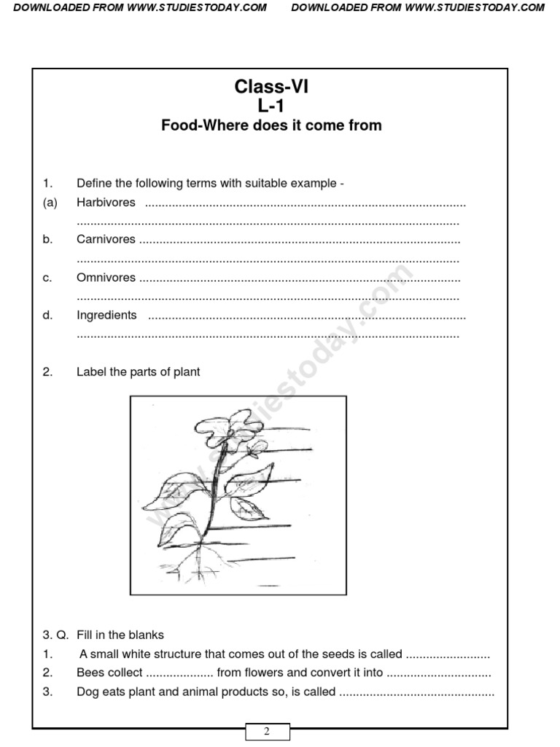

Slide 28
END

